Slide 1
SUSTAINABLE DEVELOPMENT
INTRODUCTION:
Over the last few decades, exploitation and degradation of our environment have drastically gone up at an alarming rate. Environmental issues such as global warming, acid rain, air pollution, ozone layer depletion, water pollution, climate change, etc. have raised major concern for countries, groups and organizations.
Segregation at source is critical to its recycling and disposal. Lack of segregation, collection and transportation of unsegregated mixed waste to the landfills has an impact on the environment. When we segregate waste, it reduces the amount of waste that reaches landfills, thereby taking up less space. Pollution of air and water can be considerably
reduced when hazardous waste is separated and treated separately. It is essential that waste is put in separate bins so that it can be appropriately dealt with different types of waste. Waste segregation can play a pivotal role in the improving the overall process of waste management

Slide 2
VISION AND MOTTO
Make a Clean & Green school by creating Wealth from Waste.
DON’T LET THE WASTE TO GO WASTE ..GET POINTS FOR YOUR WASTE!!!
ABOUT:
Our school students with social concern and with their diligent work and intellectual thinking have created a waste segregator namely AWSM (Automatic Waste Segregation Machine).In order to ease the process of waste management and make it more productive. The segregation of waste is the first and the most crucial stage of solid waste management process. The mixed waste becomes difficult to handle and manage because of its non-uniform composition. Waste is generally sorted using manual operations like employing the ragpickers to segregate the waste, which turns into a intensive process. Due to high input costs involved in the segregation of wastes, many urban local bodies, municipal authorities and waste management agencies restrain themselves from segregating the waste and opts for direct disposal of waste which not only increases the toxicity burden on the land but also on the environment as poorly managed landfill sites are potential sources of land, air and water pollution. However with our AWSM we can resolve this . It will result in increased efficiency of solid waste management process for better recovery and recycle rates.

Slide 3
HOW IT WORKS :
Design : The proposed AWSM consists of a Web Camera for image classification and 3 Servo motors . One common flap is placed for image classifying. Second and third flaps will be rotated according to the image sensed by the webcam with the help of Servo motors. Four bins for waste collection. One Ultra sonic sensor is placed to detect the waste level in the bins .The full mechanism is operated controlled through the help of Raspberry pi 4 , programmed with Python
Working: When the trash is placed in the common flap , the Webcam starts classifying the waste into four category (Plastic, Metal, Paper and other).After classifying the flap will open by Servo motor 1. According to the sensed waste the webcam will send signals to servo motor 2 (the second flap) for the rotation of the flap (either 0 or 360 degree). Then the waste enters to the 3rd flap where the waste is even more divided into four groups. Here the flap moves in the front and back motion(90 or 180 degree) with the help of Servo motor 3. Finally the waste enters to the respective bin.

Slide 4
CONCLUSION:
The proposed design of waste segregator system is unique in the sense that it doesn’t involve the use of conveyor belt which consequently saves on the space requirements and also makes the design less complex.Taking the world towards automatic segregation of the waste rig at the source of waste generation in a sustainable, user friendly, environment friendly and economical manner can be a breakthrough in the solid waste management system.

Slide 5
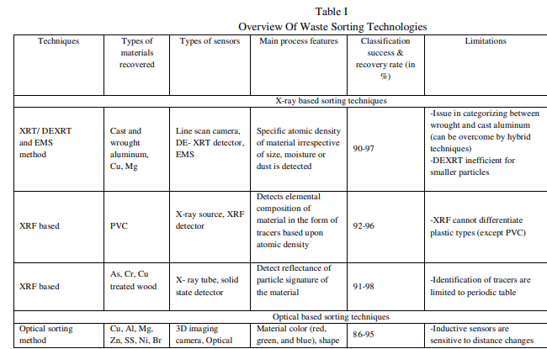
RECENTS INFO ON WASTE MANAGEMENT

Slide 6
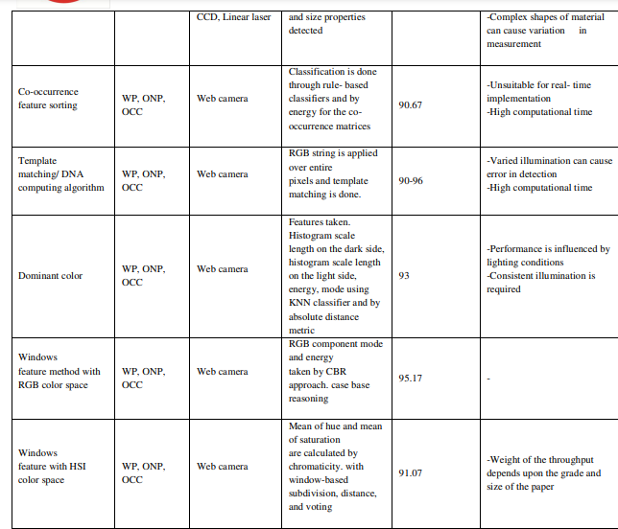

Slide 7
